Slide 1
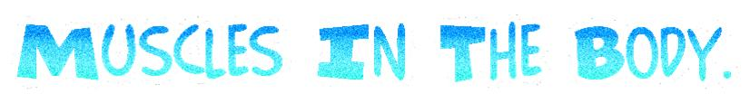

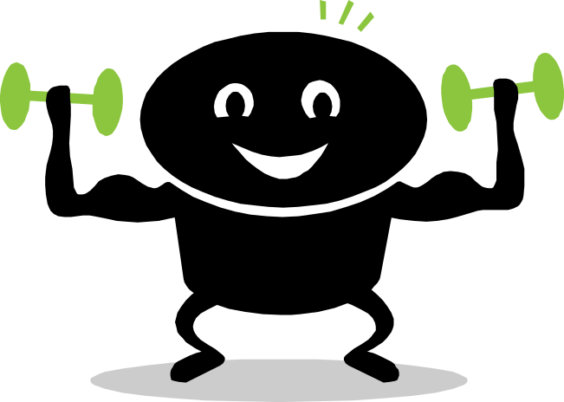

Hello and welcome to the Muscles In The Body Revision Guide. This presentation will teach you facts and then quiz you at the end to see how much you remember.
Impress your family, friends and teachers with these fascinating facts. Click on the continue arrow to go to the contents page.
Good Luck.
Continue

Slide 2
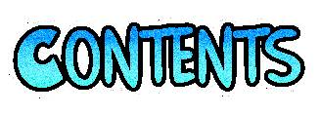
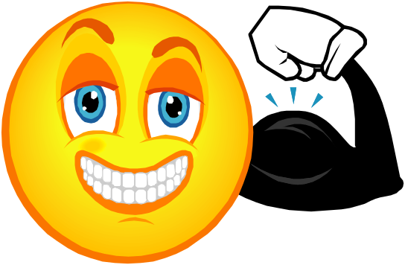
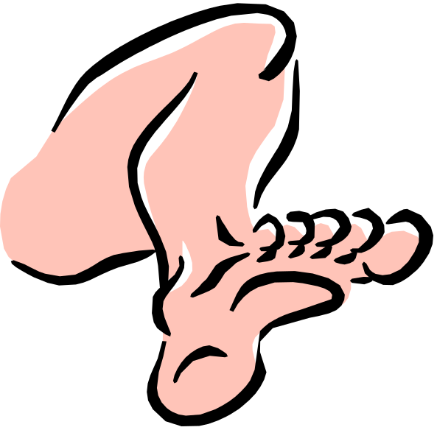
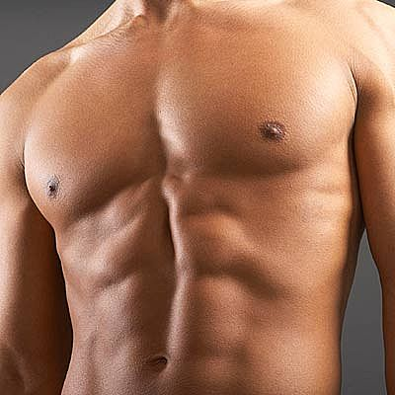

Arm Muscles.
Leg Muscles.
Core Muscles.
Click the muscle group to continue.
Quiz Time.

Slide 3
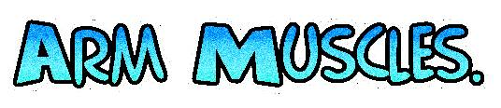
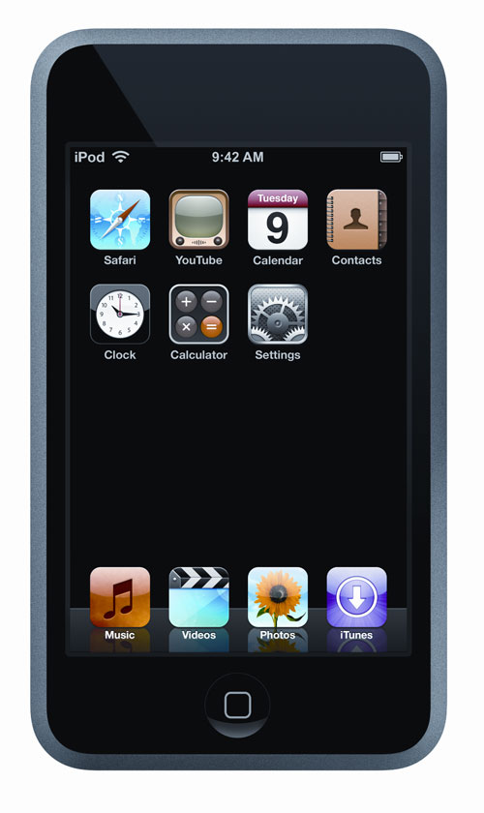
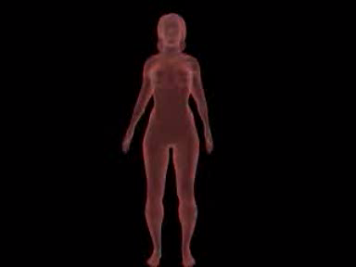
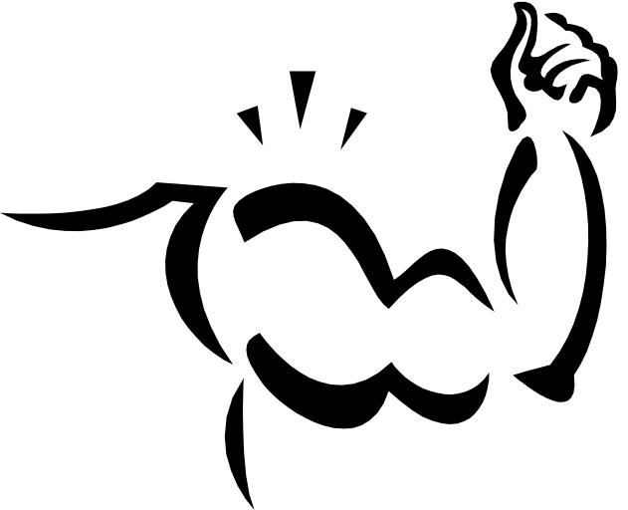
Biceps.
Video: Arm Muscles
Triceps
Biceps.
Next Muscle Group.
Triceps.

Slide 4
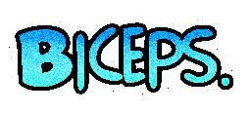
Biceps.
The Biceps is located in the upper arm
The Biceps is able to flex the elbow
The Bicep is the Latin name for “Two Headed Muscle of the arm”
The Full Latin name for the Bicep is the Musculus Bicep Branchii
Back to Arm Muscles

Slide 5

The Triceps are located on the upper on.
It’s Latin name is the Musculus Triceps Branchii
The triceps is an extensor muscle of the elbow joint
Triceps
Back to Arm Muscles

Slide 6

Quadriceps
Hamstrings
Calfs
Quadriceps
Calf
Next Muscle Group
Hamstring

Slide 7

Quadriceps
The Latin name for the Quadriceps is musculus quadriceps femoris.
It is a large muscle located at the top of the leg also known as the Thigh.
The Quadriceps are one of the most important muscles in the leg.
Back to Leg Muscles

Slide 8

The Hamstring is underneath the Quadriceps.
The Hamstrings are one of the most important muscles in the leg.
It is located at the top of the leg and above the knee.
Hamstrings
Back to Leg Muscles

Slide 9

The proper name for the calf is the Gastronemius.
The Calf is located on the lower leg behind the shin bone.
It is on of the biggest muscles in the lower leg.
Calf
Back to Leg Muscles

Slide 10

Abdominals
Pectorals
Pectorals
Abdominals
QUIZ!

Slide 11

The Abdominals are commonly known as “Abs” and “6-Pack”
The Abdominals are located over the stomach.
They are called the Abdominals because they cover the side of the Abdomen.
Abdominals
Back to Core Muscles

Slide 12

Pectorals
The pectorals are often know as the “Pecs”
They are located on the chest.
The Pectorals are one of the biggest Core Muscles.
Back to Core Muscles

Slide 13


If You Think Your Ready, Click Enter.
ENTER!
Revise Again!

Slide 14
Question 1.
Where are the biceps located?
The Leg.
The Arm.

Slide 15


Correct!
Well Done!
Back to Quiz Start.
Next Question.

Slide 16

Sorry Your Wrong.
Click the arrow to...
Revise Again
Back to Quiz Start
Revise Again.

Slide 17
Question 2.
What type of muscle are the Pectorals?
Core Muscle.
Leg Muscle.

Slide 18
Correct!
Well Done!
Back to Quiz Start.
Next Question.

Slide 19
Sorry Your Wrong.
Click the arrow to...
Revise Again
Back to Quiz Start
Revise Again.

Slide 20
Final Question.
What is the muscle in the back of the upper leg called?
Quadricep
Hamstrings

Slide 21
Correct!
Well Done!
Back to Quiz Start.
Next Question.

Slide 22
Sorry Your Wrong.
Click the arrow to...
Revise Again
Back to Quiz Start
Revise Again.

Slide 23

Well Done
You have mastered
Exit

