Slide 1


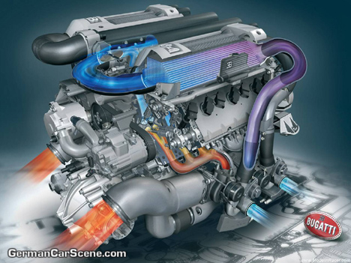
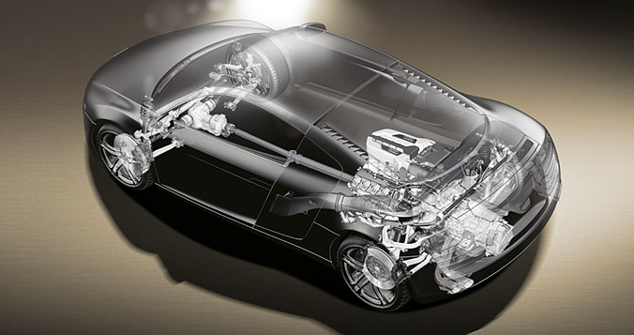
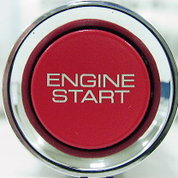
BASIC AUTOMOTIVE ENGINE PARTS
This multimedia product will help you to understand the basic Automotive Engine Parts, The engine, The gearbox, The clutch, The pistons, The crankshaft, Different types of engine and finally The Turbo. There also are six quiz Questions about the information you have learnt off this product. Please double click ENGINE START to continue to the homepage.

Slide 2
BASIC AUTOMOTIVE ENGINE PARTS
THE ENGINE
THE GEAR BOX
THE CLUTCH SYSTEM
THE PISTONS
THE CRANKSHAFT
DIFFERENT TYPES OF ENGINE
THE TURBO
QUIZ

Slide 3
BASIC AUTOMOTIVE ENGINE PARTS
THE ENGINE
There is an engine in every car. It has evolved a lot over the last 60 years. More technology, more efficiency.
The purpose of a fuel powered car engine is to convert fuel into movement so that your car can move. Currently the easiest way to create motion from is to burn the fuel inside an engine. Therefore, a car engine is an internal combustion engine. Combustion takes place inside the engine. Engine sizes can vary in different cars. E.g. a small car would have a 1.0 litre engine, as a supercar would have something like a 6.5 litre engine. This a huge difference. But its all down to the power the engine gives, and the usage it will be for.

Slide 4
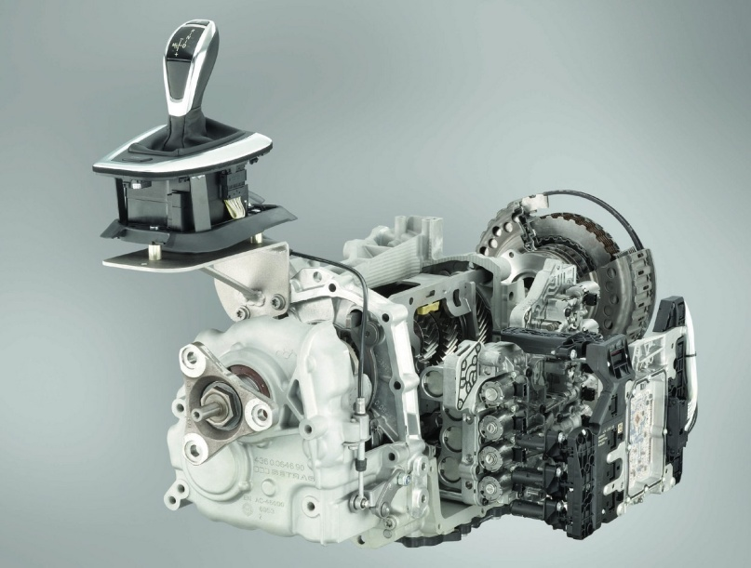
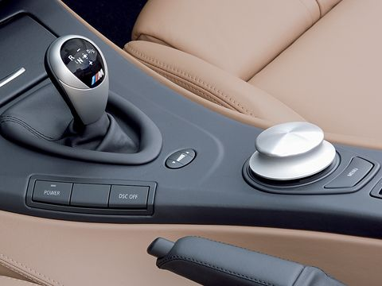
BASIC AUTOMOTIVE ENGINE PARTS
THE GEARBOX
Cars need transmissions because of the physics of the engine. First, any engine has a redline which is a maximum rpm value above which the engine cannot go without exploding. Engines have narrow rpm ranges where horsepower and torque are at their maximum. E.g., an engine might produce its maximum horsepower at 5,500 rpm. The transmission allows the gear ratio between the engine and the drive wheels to change as the car speeds up and slows down. You shift gears so the engine can stay below the redline and near the rpm band of its best performance. Most newer diesel cars have 6 gears. So do some petrol cars. The most common is 5 gears. An automatic sports car may have up to 7 gears. Automatic is exactly like a manual but you don’t change the gear the car does. Therefore you do not have to move the lever or press the clutch pedal.
The three different types of gearbox are: MAUNUAL, AUTOMATIC, SEMI AUTOMATIC and NON-SYNCHRONOUS.

Slide 5
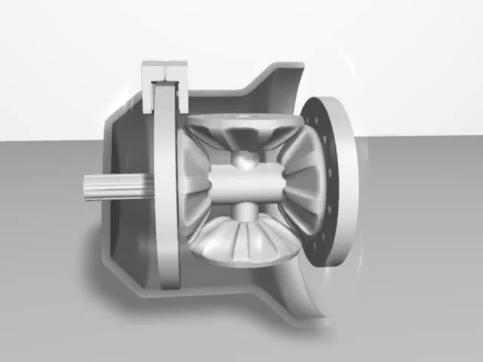
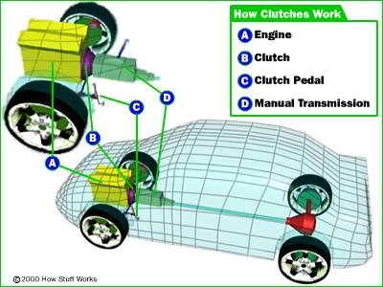
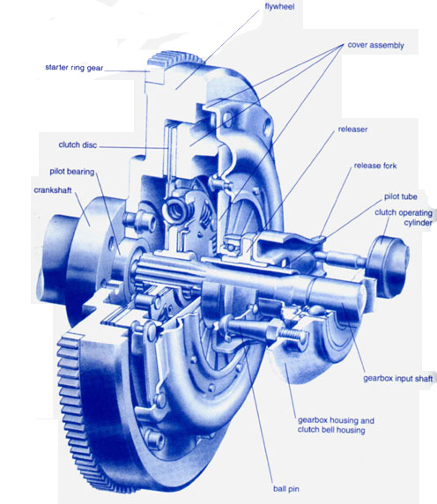
BASIC AUTOMOTIVE ENGINE PARTS
THE CLUTCH SYSTEM
In a car, you need a clutch because the engine spins all the time, but the car's wheels do not. In order for a car to stop without cutting out the engine, the wheels need to be disconnected from the engine somehow. The clutch allows us to smoothly engage a spinning engine to a non-spinning transmission by controlling the slippage between them. This disconnects the wheels from the engine. A clutch works because of friction between a clutch plate and a flywheel. Automatic cars may not have a clutch pedal, but the car calculates the clutch by itself. Did you also know that some cars have more than one clutch.
Click to play
Click on the video above.
To see how a clutch spins. when a gear changes, so does the rotation angle.

Slide 6
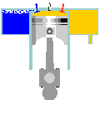
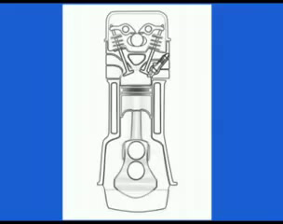
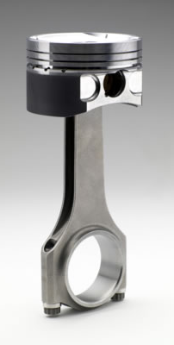
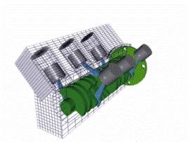
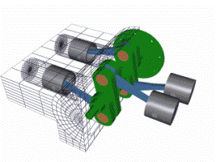
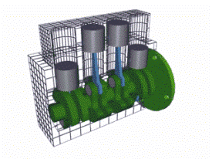
BASIC AUTOMOTIVE ENGINE PARTS
THE PISTONS
The Piston is one of the most crucial, but very much behind-the-stage part of the engine which does the critical work of passing on the energy passed to the combustion within the combustion chamber to the crankshaft. It simply carries the force of explosion of the combustion process to the crankshaft. Car pistons are the objects that are moved down by the explosion of fuel in the cylindered they are connected to a connecting rod which is in turn connected to a crank shaft that is rotated as the piston is forced down comes up and is forced down again. This is continuous as you will se in the video. There are three main types of pistons. V formations, inline and flat. You will learn more bout these on the ‘different types of engine slide’. These are the formations that the pistons are in. The video shows how the piston moves, and what it does in the engine.
Click to play
INLINE FORMATION
INLINE FORMATION
V FORMATION.
FLAT FORMATION

Slide 7
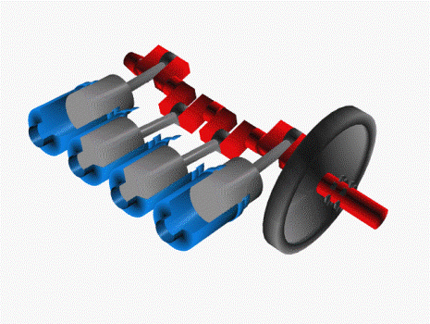
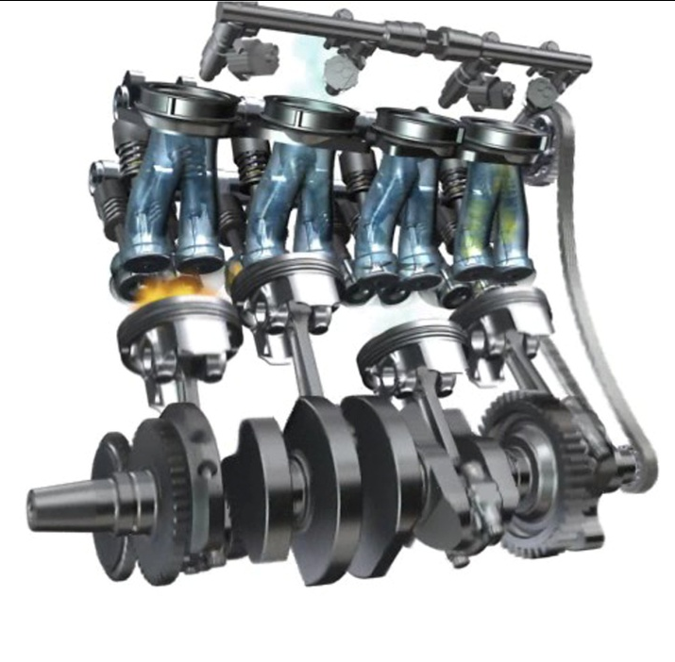
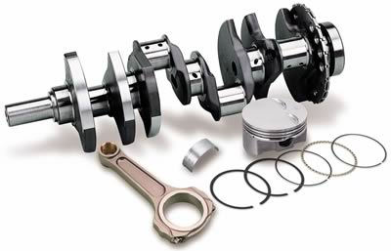
BASIC AUTOMOTIVE ENGINE PARTS
THE CRANKSHAFT.
Crankshafts are also known simply as 'cranks'. It is an arrangement that converts the linear energy into rotational one. In this arrangement, a shaft is attached to pistons with cylinders. They are four in number and the pistons move back and forth alternately. This movement is known as the four-stroke cycle. The shaft is connected to a heavy wheel or disc often called flywheel. This disc stores the kinetic energy and reduces the pulsations that may surface due to the straight movements of the pistol. The crank shaft simply moves the pistons up and down, it is also connected to the flywheel.

Slide 8
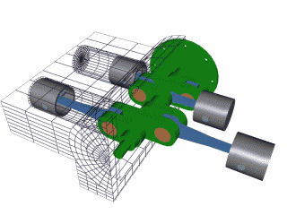
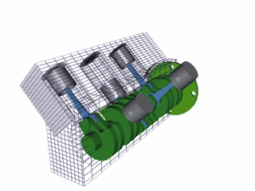
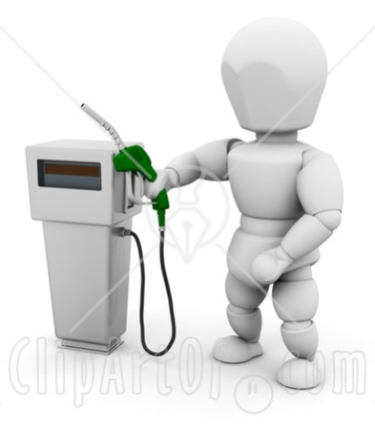
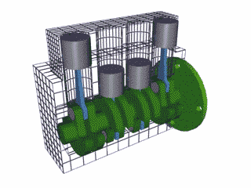
BASIC AUTOMOTIVE ENGINE PARTS
THE DIFFERENT TYPES
OF ENGINE.
There are many different types of engine. The pistons can either be in a V, inline, or flat formation, as we learnt on the pistons slide. Most high performance engines have them in a V formation. They run on different types of fuel. E.g. diesel, or petrol. But there are different powered engines like hybrids or electrical. These engines are more efficient than fuel powered ones, because they emit less CO2 gasses. Also different kinds of internal engines. Diesel engines are one form and gas turbine are another. Also rotary engines and two-stroke engines . Each has its own advantages and disadvantages

Slide 9
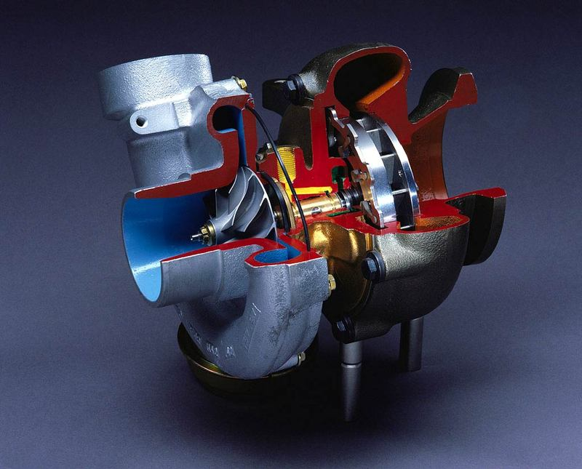
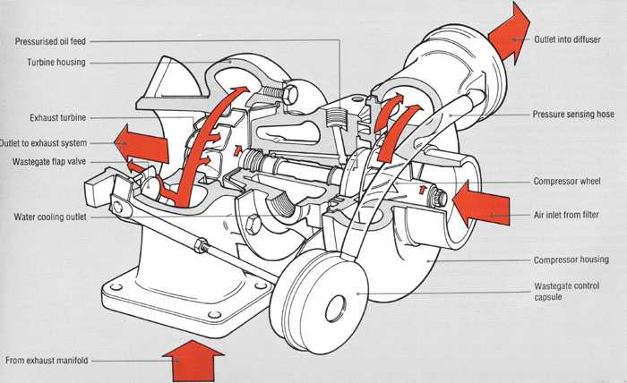
BASIC AUTOMOTIVE ENGINE PARTS
THE TURBO.
The Turbo is also referred to as the turbo charger. The turbo increases the power output of an engine while surviving extreme operating conditions. Turbochargers are a type of forced induction system. They compress the air flowing into the engine. The advantage of compressing the air is that it lets the engine squeeze more air into a cylinder, and more air means that more fuel can be added. Therefore, you get more power from each explosion in each cylinder. A turbocharged engine produces more power overall than the same engine without the charging. This can significantly improve the power-to-weight ratio for the engine. Therefore making the car faster.

Slide 10
BASIC AUTOMOTIVE ENGINE PARTS
QUIZ menu
Test yourself on what you have learnt, pick a Question
Question 1
Question 2
Question 3
Question 4
Question 5
Question 6

Slide 11
BASIC AUTOMOTIVE ENGINE PARTS
QUIZ
QUESTION 1
What are 3 the main engine layouts?
A) V, flat, inline.
B) F,V, crossline.
C) W, crossline, inline.

Slide 12
BASIC AUTOMOTIVE ENGINE PARTS
QUIZ
QUESTION 2
Which one of these is not a fuel to power an
engine?
A) Diesel
B) Water
C) Petrol

Slide 13

BASIC AUTOMOTIVE ENGINE PARTS
QUIZ
QUESTION 3
Which one of these is a type of gearbox?
A) Twin Clutch
B) Manual
C) Twin Turbo

Slide 14
BASIC AUTOMOTIVE ENGINE PARTS
QUIZ
QUESTION 4
What does the turbo do?
A) Make the car handle better
B) Help the fuel consumption
C) Give the engine more power

Slide 15
BASIC AUTOMOTIVE ENGINE PARTS
QUIZ
QUESTION 5
Which engine formation is used in performance cars?
A) V formation
B) Inline Formation
C) Flat formation

Slide 16
BASIC AUTOMOTIVE ENGINE PARTS
QUIZ
QUESTION 6
How many gears can an automatic sports car have up to?
A) 4
B) 6
C) 7

Slide 17

BASIC AUTOMOTIVE ENGINE PARTS
CORRECT !
Well done you got right !
Pick another Question.
QUIZ

Slide 18

BASIC AUTOMOTIVE ENGINE PARTS
WRONG
Sorry. You got it wrong
Please try again
QUIZ

Slide 19
BASIC AUTOMOTIVE ENGINE PARTS
EXIT
Return to home page.
EXIT.

